Slide 1
Wireless Networking Medium

Slide 2
Wireless Standards
WAN (802.20/16e) GSM,GPRS,EDGE,3G
MAN (802.16 –WiMAX) Worldwide Interoperability for Microwave Access
LAN (802.11 a/b/g/n ) WiFi wireless fidelity
PAN (802.15: Bluetooth)

Slide 3
Wireless Networking: Intangible Media
Wireless technologies continue to play an increasing role in all kinds of networks
Since 1990, the number of wireless options has increased, and the cost continues to decrease
Wireless networks can now be found in most towns and cities in the form of hot spots, and more home users have turned to wireless networks
Wireless networks are often used with wired networks to interconnect geographically dispersed LANs or groups of mobile users with stationary servers and resources on a wired LAN
Microsoft calls networks that include both wired and wireless components hybrid networks

Slide 4
The Wireless World
Wireless networking can offer the following:
Create temporary connections to existing wired networks
Establish backup or contingency connectivity for existing wired networks
Extend a network’s span beyond the reach of wire-based or fiber-optic cabling, especially in older buildings where rewiring might be too expensive
Enable users to roam with their machines within certain limits (called “mobile networking”)

Slide 5
The Wireless World (continued)
Common wireless applications include:
Ready access to data for mobile professionals
Delivery of network access into isolated facilities or disaster-stricken areas
Access in environments where layout and settings change constantly
Improved customer services in busy areas, such as check-in or reception centers
Network connectivity in structures where in-wall wiring would be impossible to install or too expensive
Home networks where the installation of cables is inconvenient

Slide 6
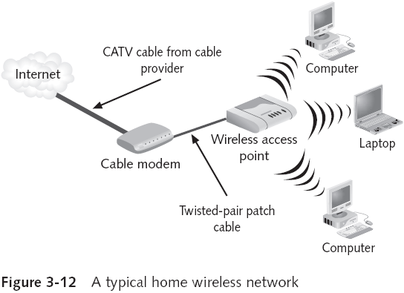
The Wireless World (continued)

Slide 7
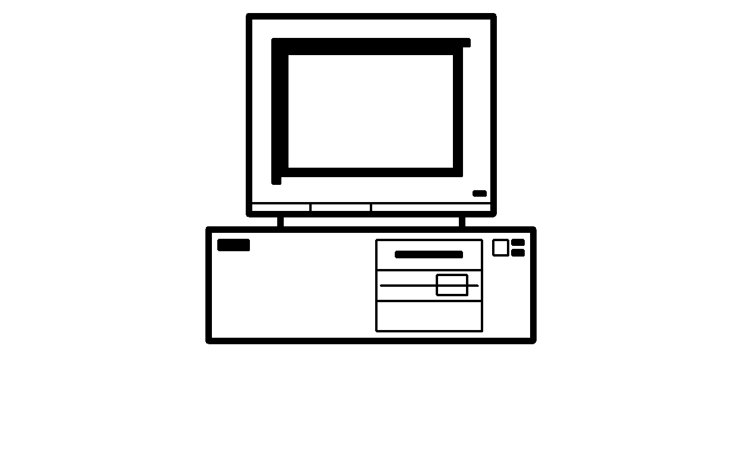
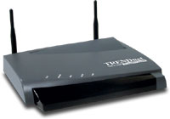
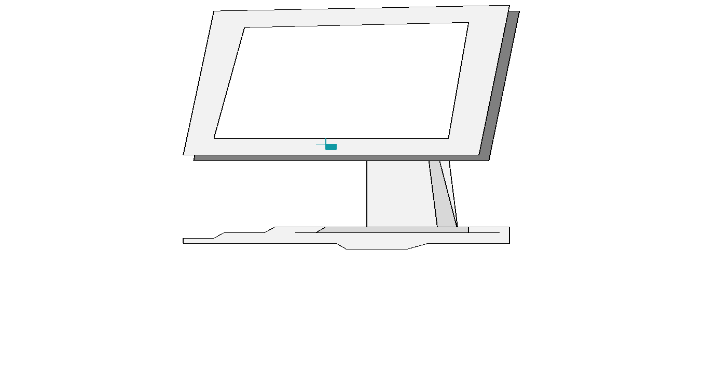

Wireless LAN
Physical Media
PC
Access Point
Internet
Router
Switch
PC
Access Point

Slide 8
Types of Wireless Networks
Three main categories
Local Area Networks (LANs)
Extended LANs
Mobile computing
An easy way to differentiate among these uses is to distinguish in-house from carrier-based facilities
Mobile computing typically involves a third party that supplies transmission and reception devices to link the mobile part of a network with the wired part
Most often, the company providing these services is a communications carrier (such as GP )

Slide 9
Wireless LAN Components
NIC attaches to an antenna and an emitter
At some point on a cabled network, a transmitter/receiver device, called a transceiver or an access point, must be installed to translate between the wired and wireless networks
An access point device includes an antenna and a transmitter to send and receive wireless traffic, but also connects to the wired side of the network
Some wireless LANs use small transceivers, which can be wall mounted or freestanding, to attach computers or devices to a wired network

Slide 10
Wireless LAN Transmission
Wireless LANs send/receive signals broadcast through the atmosphere
Waves in the electromagnetic spectrum
Frequency of the wave forms is measured in Hz
Affects the amount and speed of data transmission
Lower-frequency transmissions can carry less data more slowly over longer distances
Commonly used frequencies for wireless data communications
Radio—10 KHz (kilohertz) to 1 GHz (gigahertz)
Microwave—1 GHz to 500 GHz
Infrared—500 GHz to 1 THz (terahertz)

Slide 11
Wireless LAN Transmission (continued)
Higher-frequency technologies often use tight-beam broadcasts and require a clear line of sight between sender and receiver
Wireless LANs make use of four primary technologies for transmitting and receiving data
Infrared
Laser
Narrowband (single-frequency) radio
Spread-spectrum radio

Slide 12
Infrared LAN Technologies
Infrared light beams send signals between pairs of devices
High bandwidth (10 to 100 Mbps)
Four main kinds of infrared LANs
Line of sight networks
Reflective wireless networks
Scatter infrared networks
Broadband optical telepoint networks
Infrared transmissions are being used increasingly for virtual docking
IrDA: Infrared Device Association

Slide 13
Laser-Based LAN Technologies
Laser-based transmissions also require a clear line of sight between sender and receiver
Any solid object or person blocking a beam blocks data transmissions
To protect people from injury and avoid excess radiation, laser-based LAN devices are subject to many of the same limitations as infrared, but aren’t as susceptible to interference from visible light sources

Slide 14
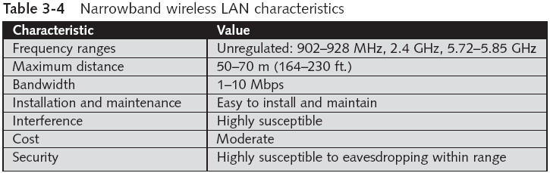
Narrowband Radio LAN Technologies

Slide 15
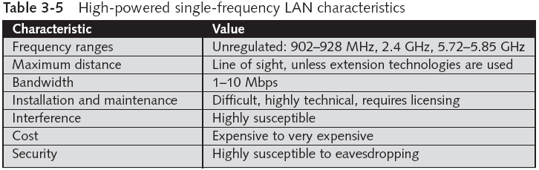
Narrowband Radio LAN Technologies (continued)

Slide 16
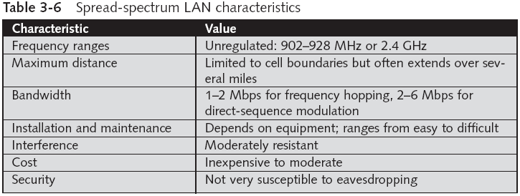
Spread-Spectrum LAN Technologies

Slide 17
802.11 Wireless Networking
The 1997 802.11 standard is also referred to as Wireless Fidelity (Wi-Fi)
Current standards include 802.11b and 802.11g running at a 2.4 GHz frequency (11 Mbps and 54 Mbps, respectively), and 802.11a, which specifies a bandwidth of 54 Mbps at a 5 GHz frequency
802.11 wireless is an extension to Ethernet using airwaves as the medium; most 802.11 networks incorporate wired Ethernet segments
Networks can extend to several hundred feet
Many businesses are setting up Wi-Fi hot spots, which are localized wireless access areas

Slide 18
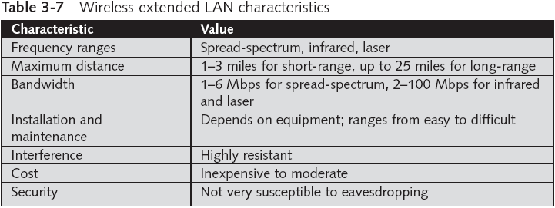
Wireless Extended LAN Technologies

Slide 19
Wireless MAN: The 802.16 Standard
One of the latest wireless standards, 802.16 Worldwide Interoperability for Microwave Access (WiMax), comes in two flavors: 802.16-2004 (previously named 802.16a), or fixed WiMax, and 802.16e, or mobile WiMax
Promise wireless broadband to outlying and rural areas, where last-mile wired connections are too expensive or impractical because of rough terrain
Delivers up to 70 Mbps of bandwidth at distances up to 30 miles
Operates in a wide frequency range (2 to 66 GHz)

Slide 20
Fixed WiMax: 802.16-2004
Besides providing wireless network service to outlying areas, fixed WiMax is being used to deliver wireless Internet access to entire metropolitan areas rather than the limited-area hot spots available with 802.11
Fixed WiMax can blanket an area up to a mile in radius, compared to just a few hundred feet for 802.11

Slide 21
Mobile WiMax: 802.16e
Promises to bring broadband Internet roaming to the public
Promises to allow users to roam from area to area without losing the connection, which offers mobility much like cell phone users enjoy
The mobile WiMax standard is not yet finalized
Expected to be approved in late 2005 or early 2006
Fixed WiMax is expected to be the dominant technology for the next several years, but mobile WiMax will win out in the end

Slide 22
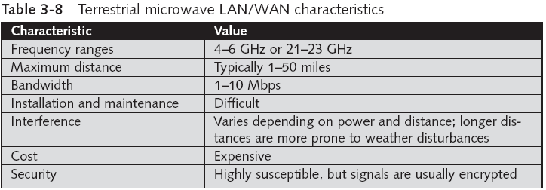
Microwave Networking Technologies

Slide 23
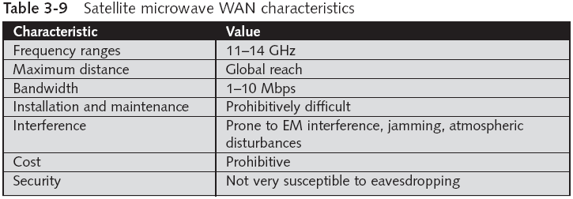
Microwave Networking Technologies (continued)

Slide 24
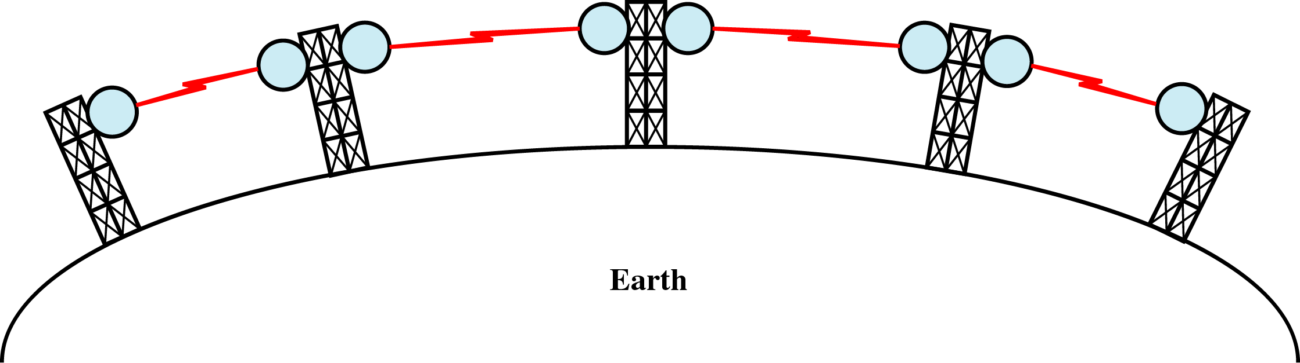
Terrestrial Microwave
Physical Media
Microwaves do not follow the curvature of earth
Line-of-Sight transmission
Height allows the signal to travel farther
Two frequencies for two way communication
Repeater is used to increase the distance.

Slide 25
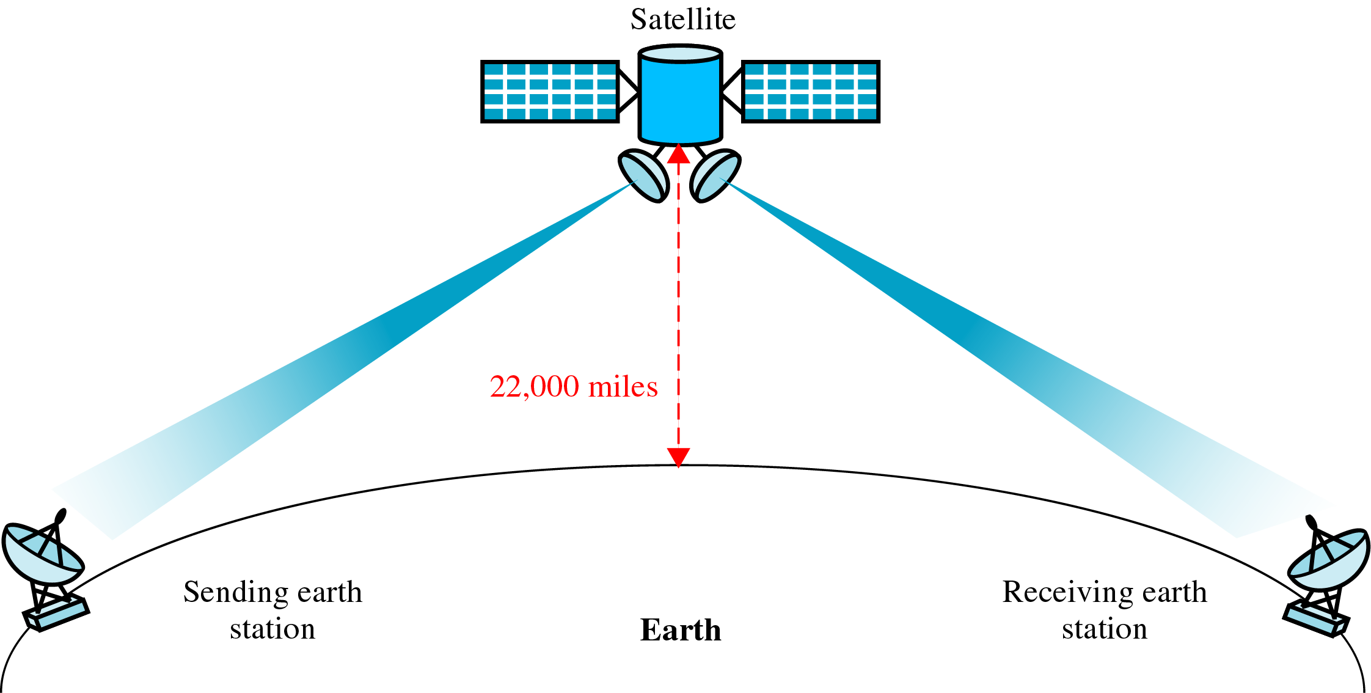
Satellite Communication
Physical Media

Slide 26
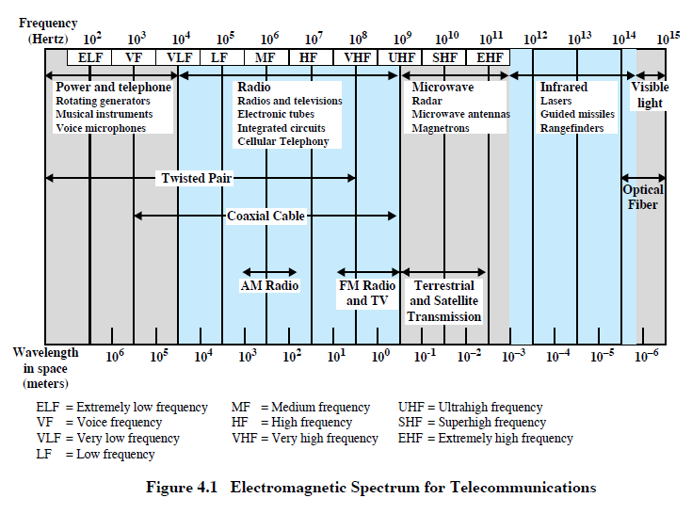
Telecommunications Spectrum

Slide 27
802.11 WLAN
IEEE standards for wireless networking
802.11a, 802.11b, 802.11g and 802.11n
Differences in speeds, distance, channels and frequencies

Slide 28
IEEE 802.11a (Wi-Fi)
Proposed in Sep 1999
It operates in the 5 GHz band
Maximum net data rate of 54 Mbit/s
Approximate indoor range 35m
Approximate outdoor rang 120m
Effective overall range of 802.11a is less than that of 802.11b/g.
Eight available channels.
Better than 802.11b at supporting multimedia voice, video and large-image applications
Relatively shorter range than 802.11b.
Not interoperable with 802.11b.

Slide 29
IEEE 802.11b (Wi-Fi)
Proposed in Oct 1999
It operates in the 2.4 GHz (ISM) band
Not interoperable with 802.11a.
Maximum net data rate of 11 Mbit/s
Approximate indoor range 38m
Approximate outdoor rang 140m
Requires fewer access points than 802.11a for coverage of large areas.
14 channels available in the 2.4GHz band with only three non-overlapping channels.

Slide 30
IEEE 802.11g (Wi-Fi)
Proposed in Jun 2003
Up to 54Mbps in the 2.4GHz band
Approximate indoor range 100m
Approximate outdoor rang 450m
Improved security enhancements over 802.11
Compatible with 802.11b.
14 channels available in the 2.4GHz band with only three non-overlapping channels.

Slide 31
IEEE 802.11n (Wi-Fi)
Proposed in Oct 2009
Up to 600Mbps in the 2.4GHz/5GHz band
Approximate indoor range 300m
Approximate outdoor rang 800m
Added new standard multiple-input multiple-output antennas (MIMO)

Slide 32
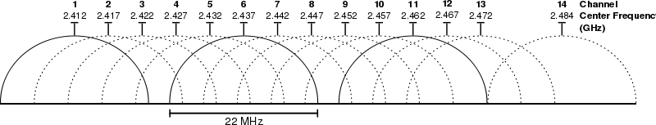
Wireless Frequency Channels

Slide 33
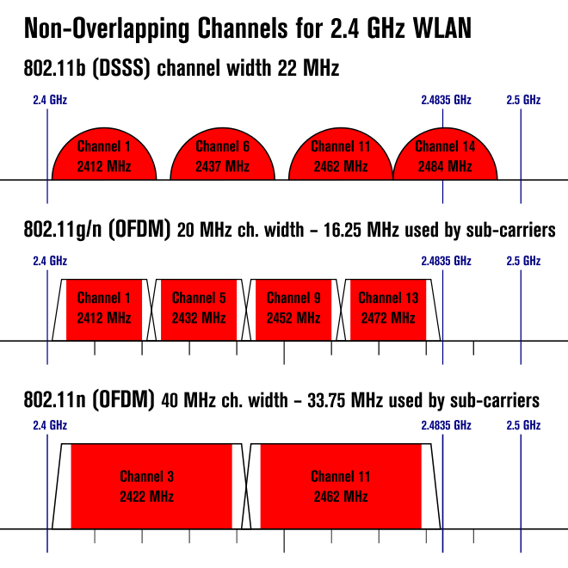

Slide 34


Slide 35
What is Bluetooth?
Short-range communications technology
Intended to replace cables connecting portable and/or fixed devices
Still able to maintain a high level of security
Defines uniform structure for wide range of devices to connect and communicate
Key features are
Robustness, low power, and cost

Slide 36
What is Bluetooth? Cont’d
A new global standard for data and voice
Intended to create a PAN
Operating range of 10 metres, with optional 100 metre mode.
Transmission power of 1 mW
Operates in free ISM band [2.4000 – 2.4835 GHz]

Slide 37
Basic Uses
Cable replacement
Voice and Data access points
Ad-hoc/temporary networking
Up to 8 devices can be networked at a time

Slide 38
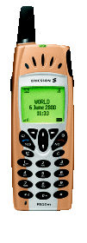
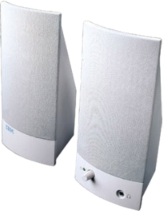



Ultimate Headset

Slide 39



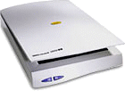
Cordless Computer

Slide 40



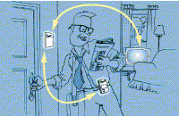
Automatic Synchronization
In the Office
At Home

Slide 41
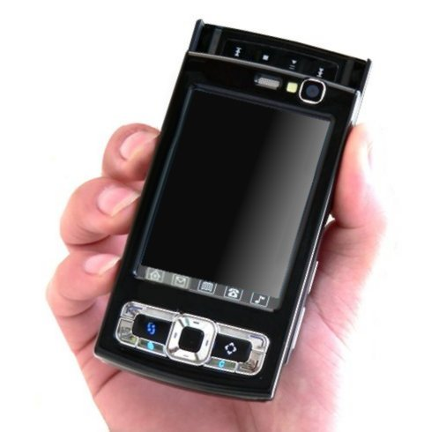
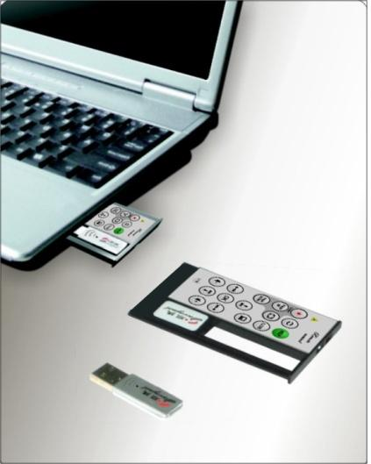


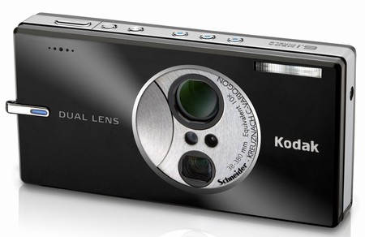
Applications of Bluetooth
Telephones
Headsets
Computers
Computer accessories
LAN peripherals
Multimedia Devices

Slide 42
Bluetooth v1.0 and v1.0B
Versions 1.0 and 1.0B had many problems, and manufacturers had difficulty making their products interoperable.
Versions 1.0 and 1.0B also included mandatory Bluetooth hardware device address (BD_ADDR) transmission in the Connecting process

Slide 43
Bluetooth v1.1
Ratified as IEEE Standard 802.15.1-2002[19]
Many errors found in the 1.0B specifications were fixed.
Added support for non-encrypted channels.
Received Signal Strength Indicator (RSSI).

Slide 44
Bluetooth v1.2
This version is backward compatible with 1.1 and the major enhancements include the following:
Faster Connection and Discovery
Adaptive frequency-hopping spread spectrum (AFH)
Higher transmission speeds in practice, up to 721 kbit/s than in 1.1.
Extended Synchronous Connections (eSCO), which improve voice quality of audio links by allowing retransmissions of corrupted packets, and may optionally increase audio latency to provide better support for concurrent data transfer.
Introduced Flow Control and Retransmission Modes for L2CAP.

Slide 45
Bluetooth v2.0 + EDR (Enhanced Data Rate)
This version of the Bluetooth Core Specification was released in 2004 and is backward compatible.
The main difference is the introduction of an Enhanced Data Rate (EDR) for faster data transfer.
The nominal rate of EDR is about 3 megabits per second, although the practical data transfer rate is 2.1 megabits per second.
EDR can provide a lower power consumption .
EDR is an optional feature.

Slide 46
Bluetooth v2.1 + EDR
Adopted by the Bluetooth SIG on July 26, 2007
The headline feature of 2.1 is secure simple pairing (SSP): this improves the pairing experience for Bluetooth devices, while increasing the use and strength of security
2.1 allows various other improvements, including "Extended inquiry response" (EIR), which provides more information during the inquiry procedure to allow better filtering of devices before connection; sniff subrating, which reduces the power consumption in low-power mode

Slide 47
Bluetooth v3.0 + HS (High Speed)
Adopted by the Bluetooth SIG on April 21, 2009
It supports theoretical data transfer speeds of up to 24 Mbit/s.
Its main new feature is AMP (Alternate MAC/PHY).

Slide 48
Bluetooth v4.0
On April 21, 2010, the Bluetooth SIG completed the Bluetooth Core Specification version 4.0, which includes Classic Bluetooth, Bluetooth high speed and Bluetooth low energy protocols.

Slide 49
Communication and connection
A master Bluetooth device can communicate with up to seven devices in a Wireless User Group.
This network group of up to eight devices is called a piconet.
The devices can switch roles, by agreement, and the slave can become the master at any time.
The Bluetooth Core Specification allows connecting two or more piconets together to form a scatternet

Slide 50
Master - Slave
Master
Device in Piconet whose clock and hopping sequence are used to synchronize all other devices (slaves) in the Piconet.
It also carries out Paging procedure and also Connection Establishment.
Slaves
Units within the piconet that are syncronized to the master via its clock and hopping sequence.
After connetion establishment, Slaves are assigned a temporary 3 bit member address to reduce the no. of addresing bits required

Slide 51
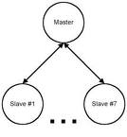
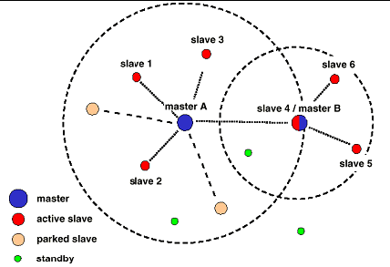
Pico Net
Scatter Net

Slide 52
WiMAX
Worldwide Interoperability for Microwave Access
It is a telecommunications protocol that provides fixed and mobile Internet access.
The current WiMAX revision provides up to 40 Mbit/s with the IEEE 802.16m update expected to offer up to 1 Gbit/s fixed speeds.
The name "WiMAX" was created by the WiMAX Forum, which was formed in June 2001

Slide 53
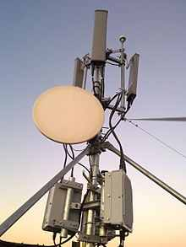
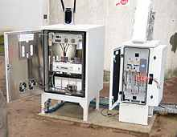
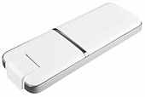

Slide 54
General packet radio service (GPRS)
It is a packet oriented mobile data service on the 2G and 3G cellular communication systems global system for mobile communications (GSM).
The service is available to users in over 200 countries.
GPRS usage charging is based on volume of data, either as part of a bundle or on a pay-as-you-use basis.

Slide 55
Enhanced Data Rates for GSM Evolution (EDGE)
It is a digital mobile phone technology that allows improved data transmission rates as a backward-compatible extension of GSM.
EDGE/EGPRS is implemented as a bolt-on enhancement for 2.5G GSM/GPRS networks.

Slide 56
Evolution-Data Optimized (EV-DO)
It is a telecommunications standard for the wireless transmission of data through radio signals, typically for broadband Internet access.
It uses multiplexing techniques including code division multiple access (CDMA) as well as time division multiple access (TDMA)

Slide 57
High-Speed Downlink Packet Access (HSDPA)
It is an enhanced 3G (third generation) mobile telephony communications protocol in the High-Speed Packet Access (HSPA) family,
Which allows networks based on Universal Mobile Telecommunications System (UMTS) to have higher data transfer speeds and capacity.
Current HSDPA deployments support down-link speeds of 1.8, 3.6, 7.2 and 14.0 Megabit/s.
Further speed increases are available with HSPA+, which provides speeds of up to 42 Mbit/s

